Slide 1
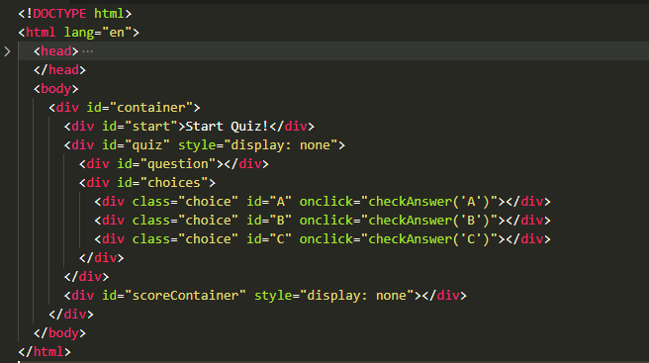
start
quiz
scoreContainer
question
QUESTION ??
choices
A
B
Start QUIZZ
Score : 80%
Answer A
Answer B
Answer C
Answer D
C
D

